Slide 1
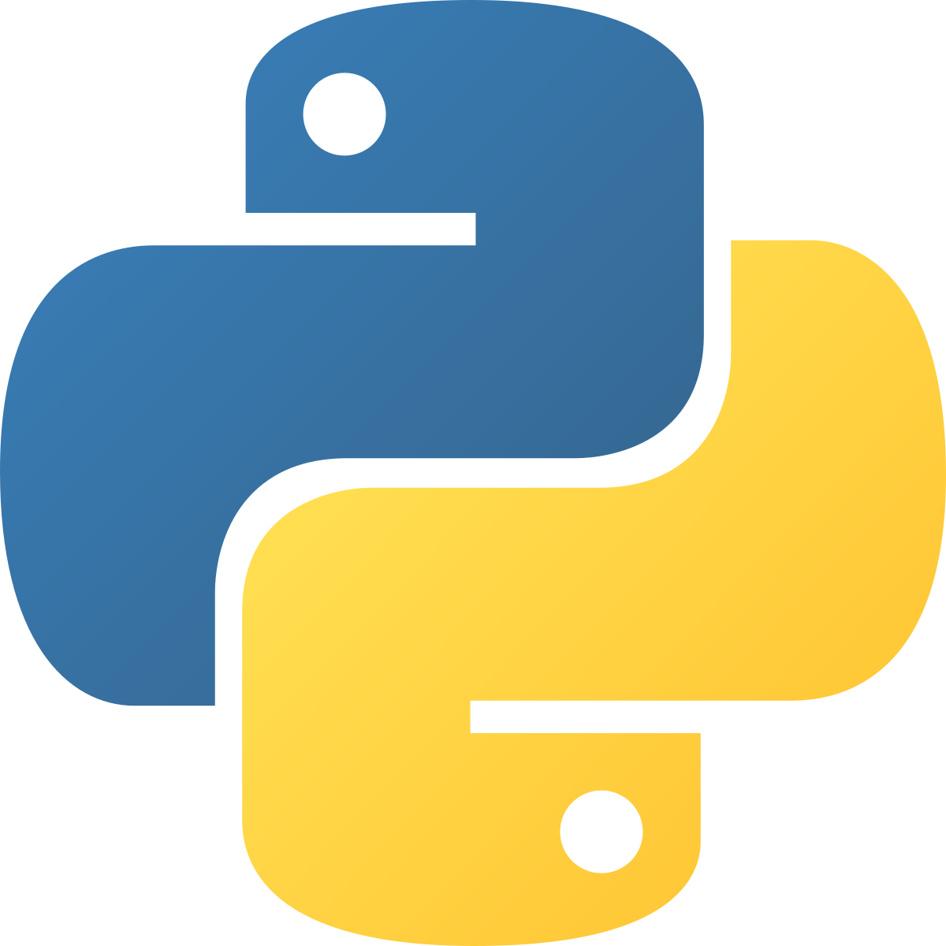
Introduction to Python
Glen Issac | Code Ninjas

Slide 2
Ice-Breaker Question!
Do you like snakes? What are your favourite kind?

Slide 3
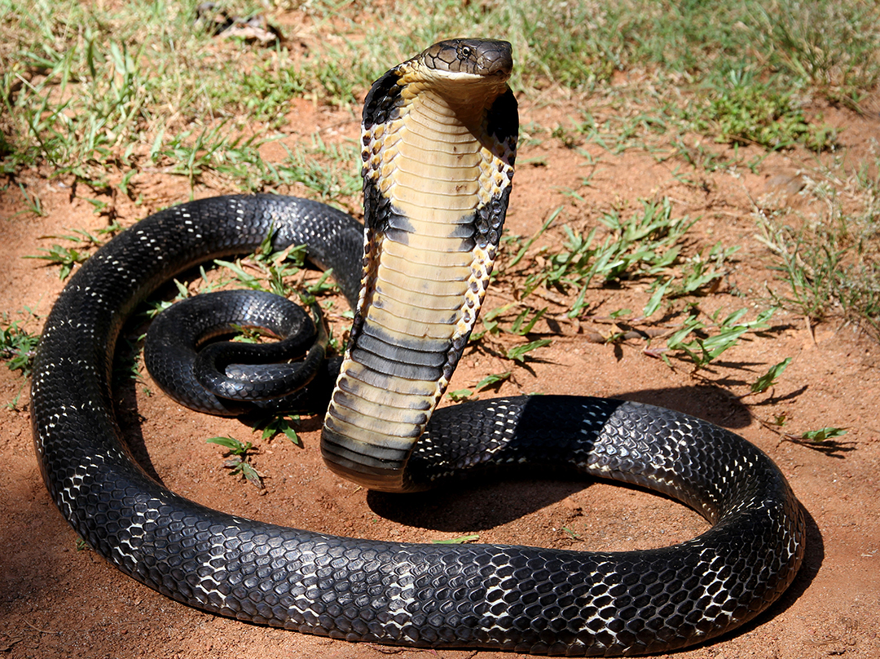
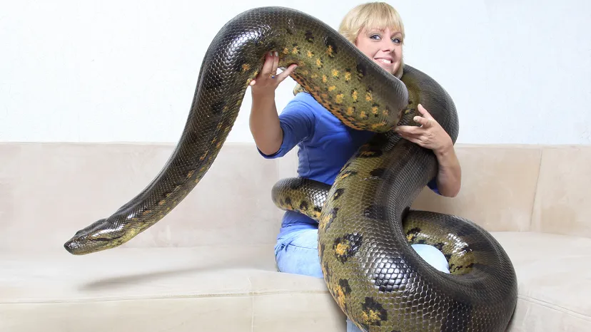
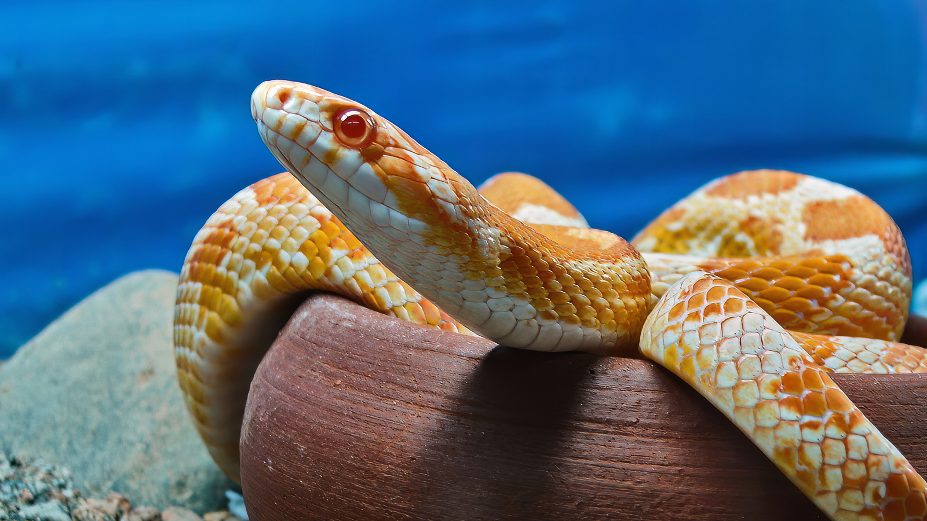
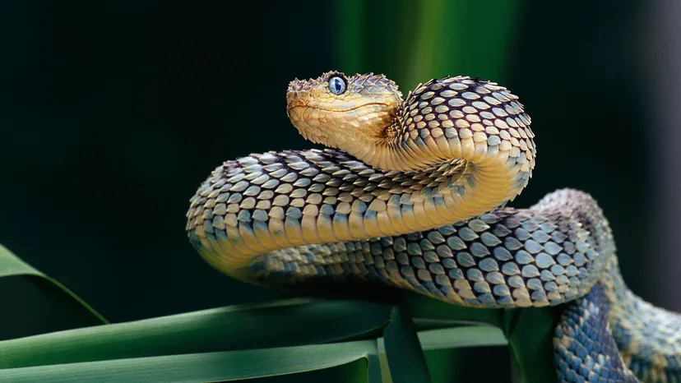
King Cobra
Anaconda
Corn Snake (Cornelius!)
Viper

Slide 4
We’ll be learning about a similar kind of snake today…

Slide 5
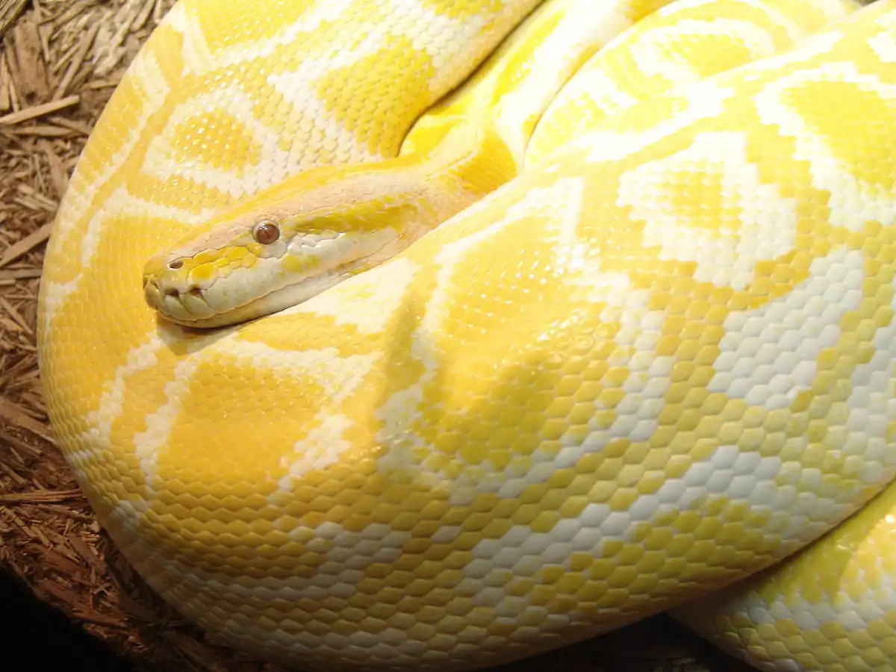
A Python…

Slide 6
That doesn’t look right!

Slide 7
Ah yes! This Python

Slide 8
Table of contents
01
02
03
04
Brief History
The Python IDE
A quick rundown on the history of Python
What are we going to use for Python?
Hands-On
Conclusion
Let now actually work with Python!
The end!

Slide 9

01
Brief History of Python

Slide 10
What is Python?
Python is a popular programming language. It was created by Guido van Rossum, and released in 1991.
It is used for:
web development (server-side),
software development,
mathematics,
system scripting,
game development.

Slide 11
Python in our Daily Lives
A lot of the apps that we use day-to-day are built on..
rhymes with python… you guessed it, its Python!

Slide 12
Some Of Them Are..

Slide 13

Netflix

Slide 14

Spotify

Slide 15

Instagram

Slide 16

Uber

Slide 17
..And Many More!

Slide 18
Why should I learn Python?
Python is a high-level language, which means it is similar to English.
It works on almost all platforms (Windows, Mac, Linux etc.).
It is a great starter language to diversify into different languages (C/C++, C#, Java etc.).
It is versatile, beginner friendly and has a high demand in popular fields like AI and data science!

Slide 19
02
The Python IDE

Slide 20


The Python Notebook
We will be working on Python Notebooks (.ipynb) for the purpose of this workshop!
This helps us run our code in our notebooks itself!

Slide 21
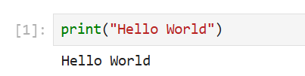
Some Basic Python Commands…
The print() function helps us display a message in our notebook!
print(“Hello World”) will display Hello World on our notebook! Let’s try it out on our notebook!

Slide 22
The if-else Conditional
You might be familiar with Conditionals from White Belt!
Like humans, Computers can make decisions as well based on situations presented to them! Let’s go over some examples.

Slide 23
We use Conditionals Everyday!
#Example 1
if you’re hungry:
Eat a Snack! 🍎
else:
Keep playing! 🎮
#Example 2
if it is your birthday:
Eat a Cake!
print(“Happy Birthday!”) 🎂
else:
Eat your veggies 😈

Slide 24
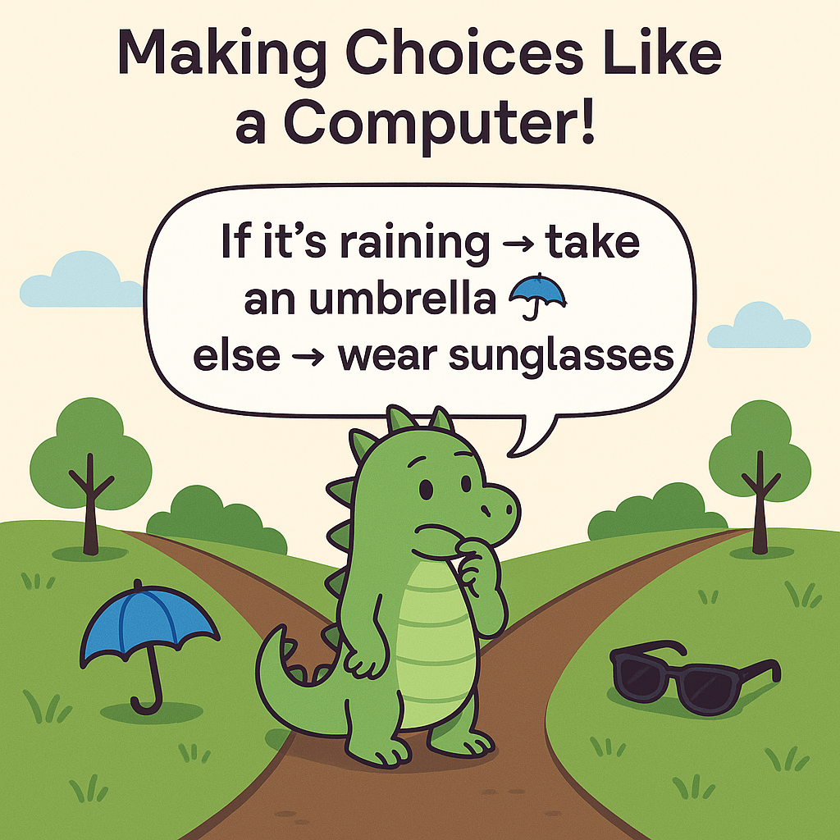

Slide 25
Syntax for Conditionals on Python
if condition:
# do something
else:
# do something else

Slide 26
Variables
A variable is a name we give to something so we can use it later!
💡 Think of variables as boxes, each of them storing something inside.
📦 name = “Alex”
📦 age = 10
📦 score = 100.0

Slide 27
Data Types for Variables in Python
Integers (int)
Strings (str)
Whole Numbers! (100, 70)
Collection of letters and words! (“Hello!”)
Booleans (bool)
Float(float)
Yes or No answers (True/False)
Numbers with Decimals (100.5, 70.2)

Slide 28
03
Time for a Hands-On!

Slide 29
Time to Code!
Let’s switch over to our Python Notebook to learn how to apply what we’ve learnt so far on Python :)

Slide 30
04
Conclusion

Slide 31
What we learnt today
Good job everyone! You’ve officially reached the end of our Python
Workshop 😎
Each one of you is now a Python Ninja who can write real code! 💻✨
Today we learned all about:
🖨️ Print Statements – how to talk to Python
🔀 If–Else Conditionals – how to make smart choices
🧩 Data Types – the different kinds of things Python understands
You did amazing — keep practicing, keep exploring, and keep coding! 🚀
Thank you for coming!

Slide 32
What’s Next? 🕵️
🕵️ We will be doing a workshop on Cryptography on November 19th.
🕵️ It will be based on Python.
🕵️ Be there or be square.
🕵️ See you there! ☺

Slide 33
References
King Cobra – wiki
Anaconda – Animals/HowStuffWorks
Corn Snake - Animals/HowStuffWorks
Viper - Animals/HowStuffWorks
Python - InfoWorld

Slide 34
Thanks!
Do you have any questions?
glenissac392@gmail.com
+1 (639) 554 – 5833
linkedin.com/glen
Please keep this slide for attribution

Slide 35
Icon pack

